Slide 1


NBA FAN TWEETS ENGAGMENT
An analysis of tweets made in the first month of NBA kickoffs.

Slide 2

Overview
Prior Expectations
Data exploration & Problem Statement
Business Insights/Recommendations
Conclusion

Slide 3
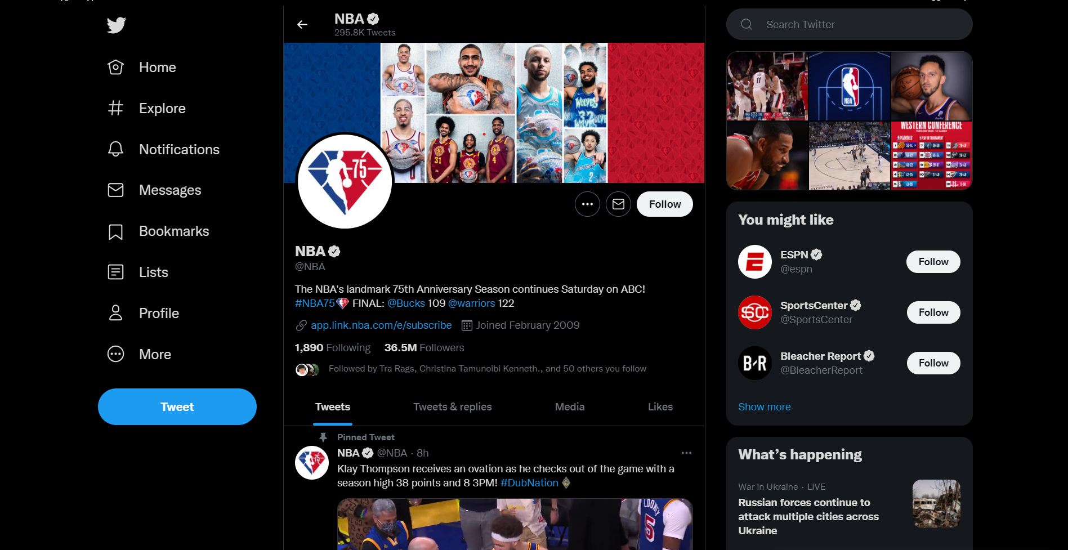
DATASET
NBA October 2019 Fan Tweet Engagements.
library(dplyr) # Load dplyr package
library(readr) # To import csv file
NBA <- read_csv("A_Oct2019.csv")

Slide 4
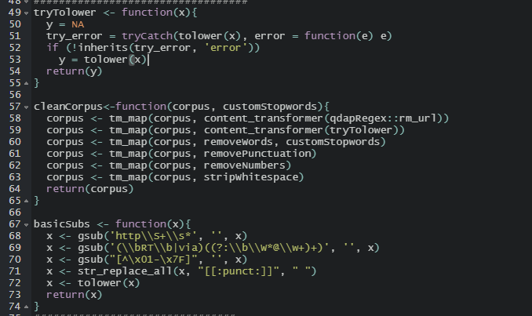
Custom cleaning functions- udf
tryTolower – turns all characters to lower case.
cleanCorpus – custom UDF to apply basic cleaning operations on text
basicSubs – custom UDF added as an additional option to preprocess text

Slide 5
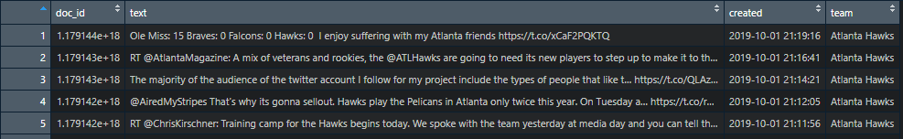
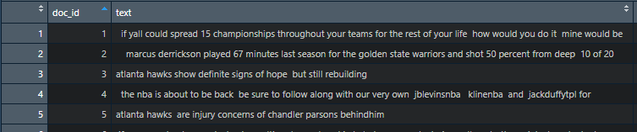
CLEANING AND PREPROCESSING STEPS 1.
Extract a representative sample of the dataset across the entire month (20%)
Apply basicSubs function to remove @,RTs and other unneeded characters.
Numbering doc_id variables and remove unneeded columns.

Slide 6
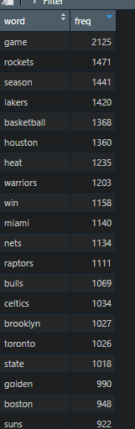
CLEANING AND PREPROCESSING STEPS 2.
Define
Define Stopwords.
Make
Make a Volatile Corpus (VC)
Apply
Apply cleanCorpus on VC, include Stopwords.
Make
Make a TermDocumentMatrix with processed corpus
Create
Create a frequency table sorting high frequent terms first
Frequency table sample output

Slide 7
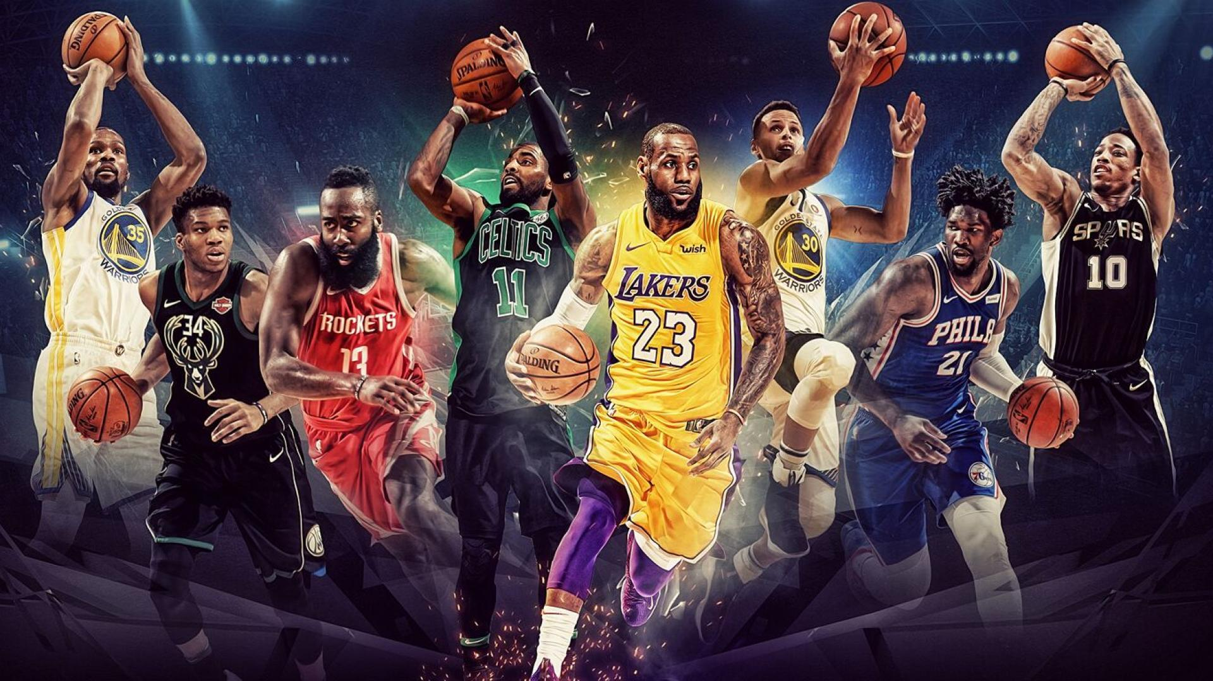
Business insights/Recommendations

Slide 8
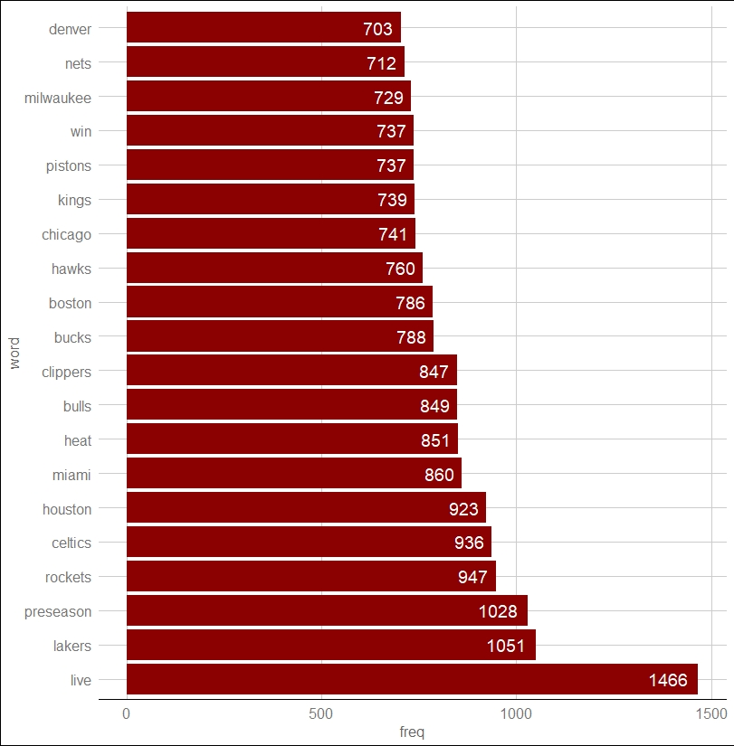
Conference and Division leagues.
Highest occurring words center around terms common in Teams in the Eastern Conference such as Celtics (Boston Celtics), Milwaukee (Milwaukee Bucks)
Pacific & Central Divisions contain the most teams being talked about in the league. (LA Clippers, Sacramento Kings) & (Chicago Bulls, Denver Nuggets)

Slide 9
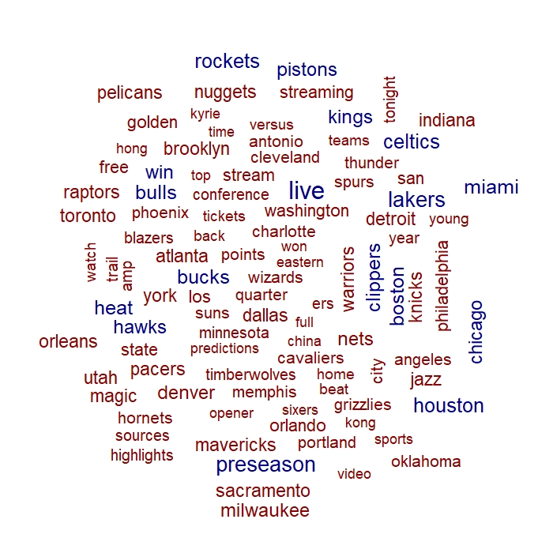
WordCloud
“live”, “streaming” & “china” are high frequency words that attract further analysis due to their uniqueness.
Word Associations to investigate certain words.

Slide 10
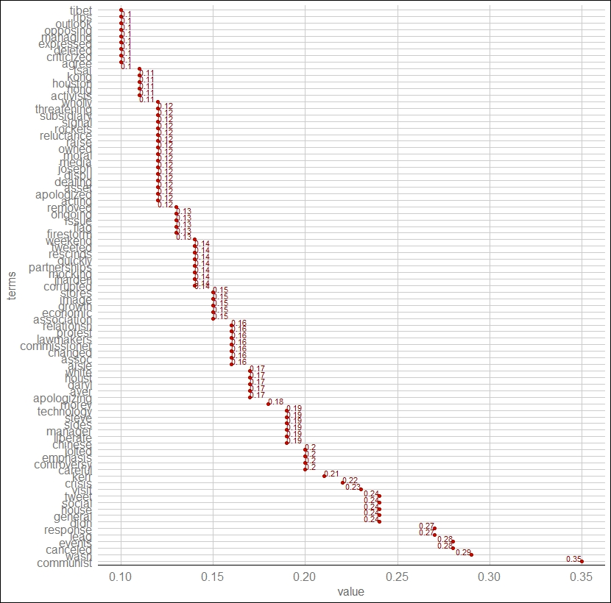
The rockets-cHINA-NBA FALLOUT 1.

Slide 11
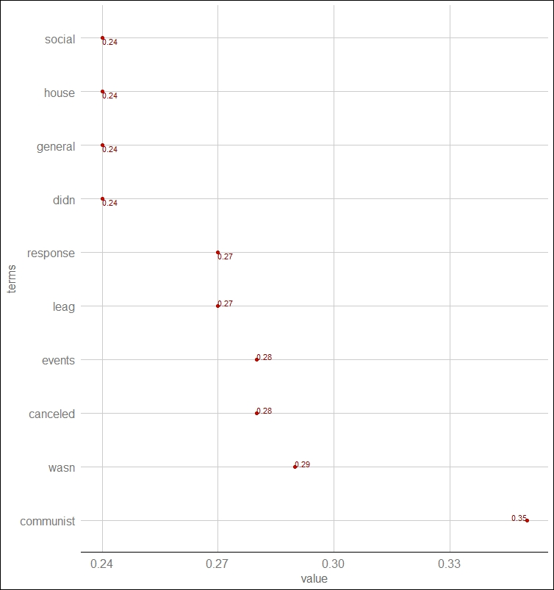
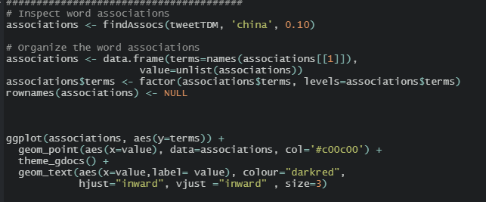
China association 2.

Slide 12
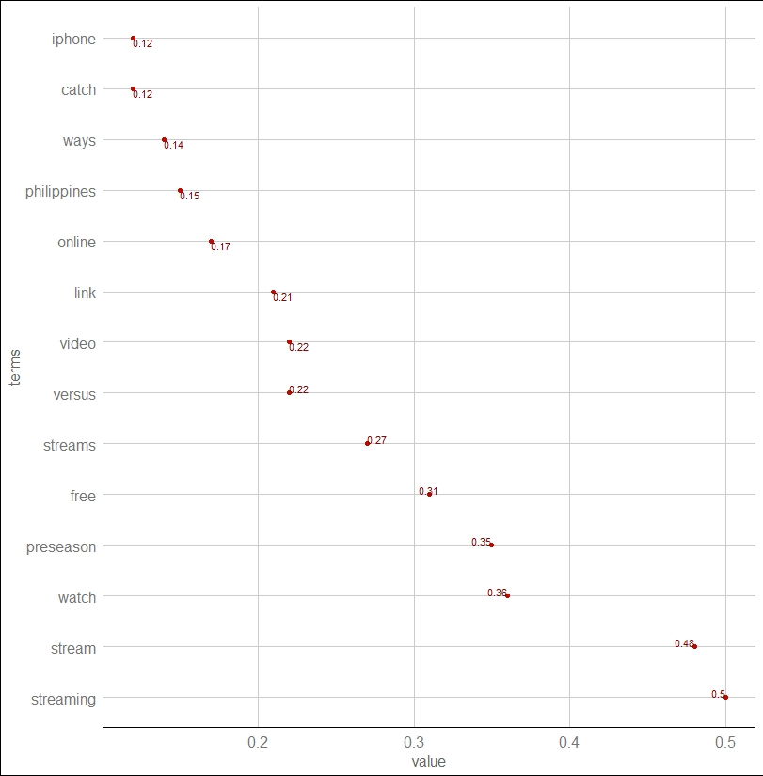
Live association
Possibility to generate ads to air on streaming services for Nike products.

Slide 13
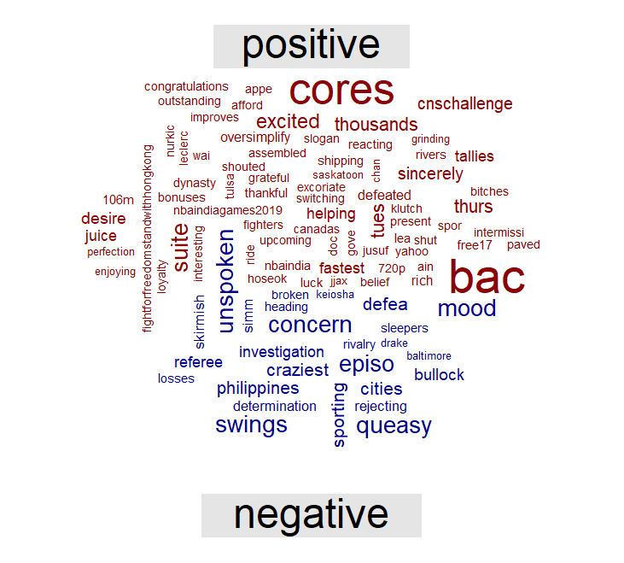
Polarity analysis
A General Positive mood in the first month, with key events such as cnc challenge (BTC) and india games and the Hong Kong Protests.

Slide 14
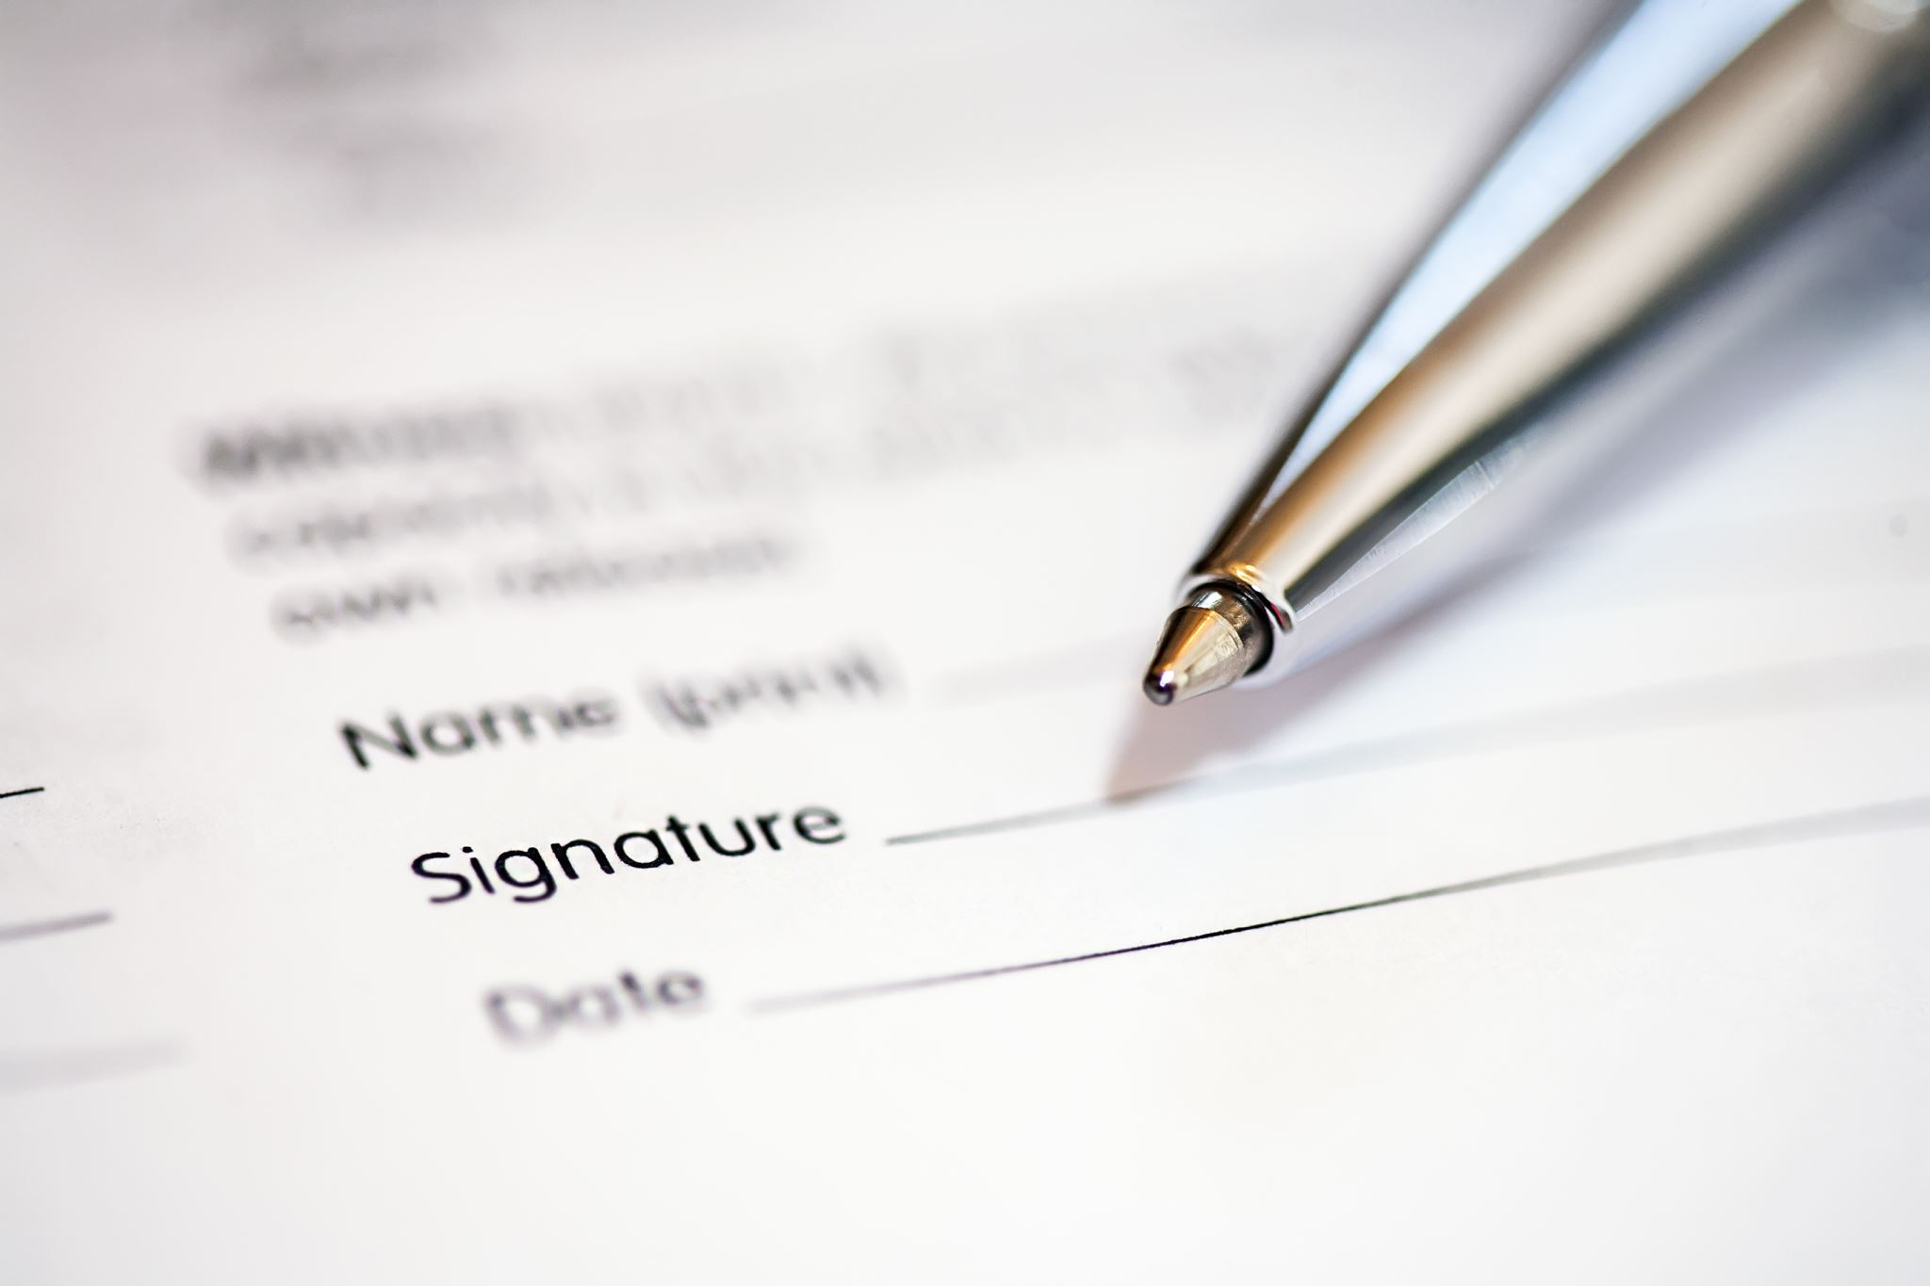
Conclusion

Slide 15


